Slide 1
Recitation 6
Greg, Will, Sheil

Slide 2
Agenda
Motor Selection Exercise
Feedback Control (PID)
Mini-Design Review

Slide 3
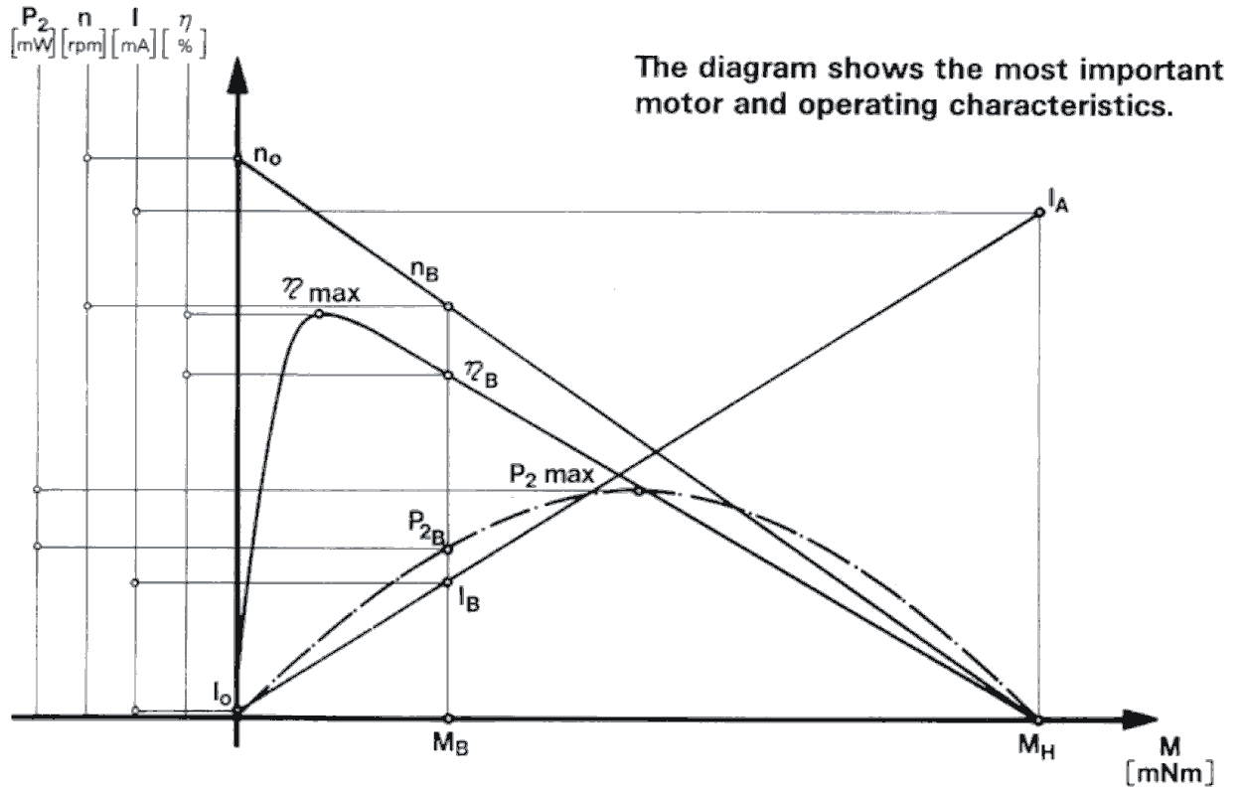
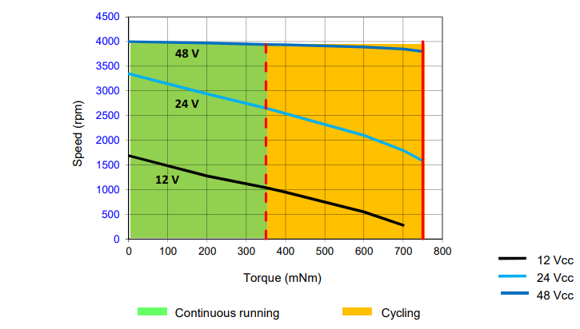
Choosing the right motor for a design
Motor specs only include values around stall torque, no-load speed etc.
However, we need to know torque at a different speed or design point
Source: BLDC motor on Digikey
Notes:
Why does the curve on the right have a region for continuous running and cycling?
Continuous rated torque is the motor's continuous torque that it can output at rated speed, close to the max speed of the motor. This is a better judge of the motor's performance as it's the motor's torque at speed.
Cycling / Peak torque is the motor's maximum torque it can output for a short period of time, typically for acceleration/deceleration or overcoming friction. Our motors are rated for 10% duty cycle and thus the peak torque is 3.1 times the continuous stall torque.

Slide 4
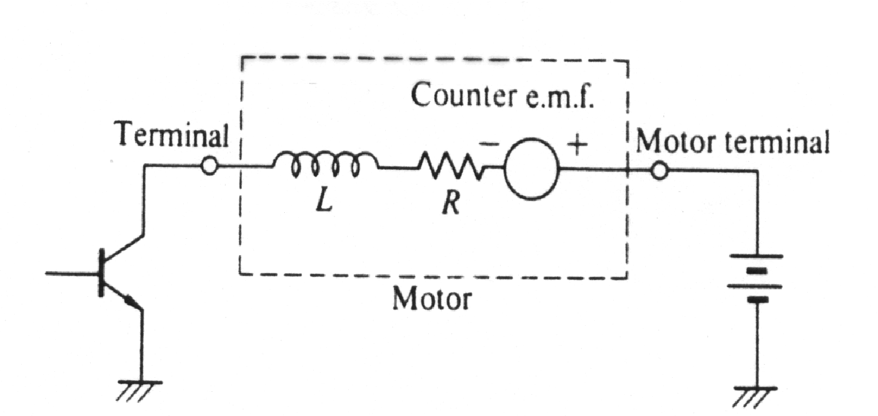
Refresher on the Ideal Electrical Model of a DC motor with a battery
Voltage drop across Inductor | L di/dt
Voltage drop across Resistor | iR
Induced Voltage | K_{E} ω
V
V = L di/dt + iR + K_{E} ω
Kirchoff's Voltage Law
Steady state
V = 0 + iR + K_{E} ω
Speed vs Torque
Assume no friction
τ = K_{T} i
Free RPM N_{F}
(since torque = 0)
Substitution Algebra
V = τR/K_{T} + K_{E} ω
Speed [rad/s]
ω = - τ R/(K_{T}K_{E} ) + V/K_{E}
Stall torque T_{S} (since speed = 0)
Motor Constant
τ Torque [Nm]
Notes:
In the simple electrical motor model, the motor basically contains a number of inductors, that move in a magnetic field. The inductors themselves have an inductance, and some internal resistance. Their movement will generate a voltage across the inductors, which is dependent on rotational velocity.
Why is voltage drop across inductor 0 in steady state? The definition of the inductance itself gives the answer. It is the property of material to oppose the change in current. In DC circuits, there is no change in current (i.e. di/dt = 0), hence no opposition in turn reactance is offered to the DC current.

Slide 5
Problem: Choosing the right motor for a design
You are handed a motor. The only documentation that you can find shows that the motor has K_{T} = 9.33 in.-oz./A and produces 2.8 in.-oz. at stall when driven at 12V.
The design requires that the motor deliver 0.4 in.-oz. at 1500 rpm from a 12V supply.
Also, K_{T} = 1.3524 K_{E} [K_{T} in oz-in/A; K_{E} in V/krpm]
How can I find out how much current the motor will draw at stall?
Find the coil resistance.
What is K_{E}?
Will the design meet the requirements for torque at the given speed? If not, what changes could you suggest?
Estimate the current required when running at the design point.
Notes:
For Q1: torque= K_{T} I
For Q2: Why do we know that the voltage across the resistor is 12V @ Stall?
di/dt is zero at stall, so no drop across inductor
Omega = 0 so no Back-EMF induced in the coil
12 = IR

Slide 6
Solution: Choosing the right motor for a design
You are handed a motor. The only documentation that you can find shows that the motor has K_{T} = 9.33 in.-oz./A and produces 2.8 in.-oz. at stall when driven at 12V.
The design requires that the motor deliver 0.4 in.-oz. at 1500 rpm from a 12V supply.
Also, K_{T} = 1.3524 K_{E} [K_{T} in oz-in/A; K_{E} in V/krpm]
How can I find out how much current the motor will draw at stall?
Find the coil resistance.
What is K_{E}?
τ = K_{T} I
I = T/K_{T} = 2.8/9.33 = 300mA
V=IR @ stall, R = V/I = 12/.301 = 40 ohms
K_{E} = K_{T} / 1.3524 = 9.33/1.3524 = 6.90 V/krpm

Slide 7
Solution: Choosing the right motor for a design
You are handed a motor. The only documentation that you can find shows that the motor has K_{T} = 9.33 in.-oz./A and produces 2.8 in.-oz. at stall when driven at 12V.
The design requires that the motor deliver 0.4 in.-oz. at 1500 rpm from a 12V supply.
Also, K_{T} = 1.3524 K_{E} [K_{T} in oz-in/A; K_{E} in V/krpm]
Will the design meet the requirements for torque at the given speed? If not, what changes could you suggest?
Estimate the current required when running at the design point.
w = -(R/(K_{T} K_{E})) T + V/K_{E}
1.5 = -(40/(9.33*6.9)) T + 12/6.9
1.5 = -0.621 T + 1.739
T = .385 oz in
V - K_{E} w - IR = 0
12V – 6.9*1.5 – I*40 = 0
→ I = 1.65 / 40 = 41mA
Notes:
Note: for Q4, we are using 1.5 for w, because units for angular velocity are krpm to stay consistent with units of K_{E}
Changes to increase torque:
Decrease RPM
Increase supply voltage

Slide 8
Feedback Control
Examples of feedback control
Thermostat
Humidifier
Cruise control
Position control (Robotics)

Slide 9
Control diagram / Terminology
Controller
input
Plant
(oven/car/robot)
Terms:
Plant
Controller
Sensor
Actuator
Disturbance
state
Plant
input
Actuator
Dynamics
Sensor
state
disturbance

Slide 10
Control diagram / Terminology
Controller
input
Plant
(oven/car/robot)
state
Terms:
Regulator (set point)
Step Response
Controller
state
Control Law
input
Set Point (from user/external source)

Slide 11
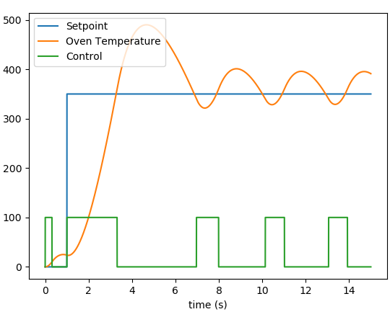
Example: Oven
Input: [status of the heating element (off/on)]
State: [temperature of the oven]
How do we get the oven to a desired temperature?
Hysteresis is often added to reduce switching
This type of control is called bang-bang

Slide 12

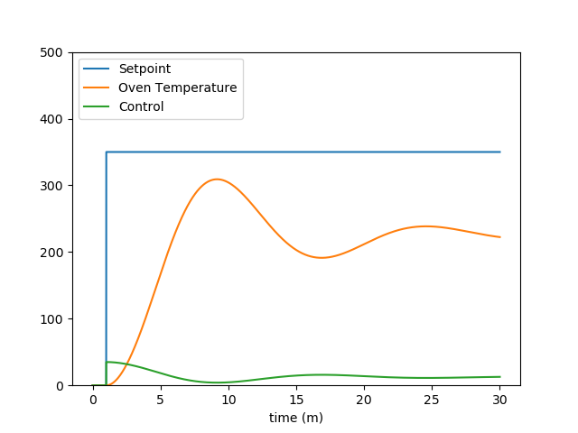
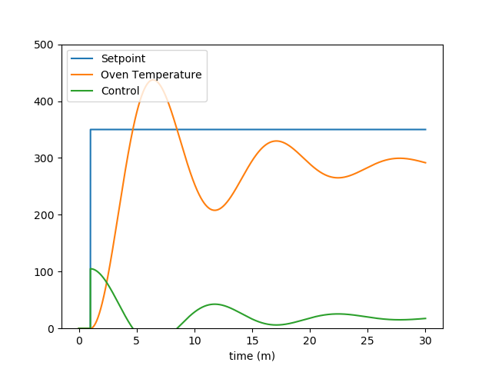
Proportional Control (P)
We often have more control fidelity than just on/off
Idea: apply inputs that are proportional to the amount of error
Increasing Kp
Simplest and most common form of control

Slide 13
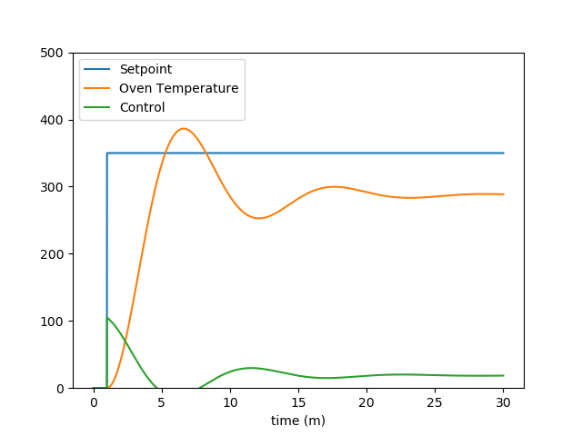
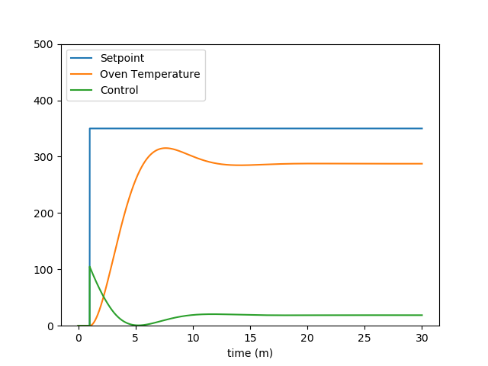
Proportional Derivative Control (PD)
How do we reduce the oscillations?
Idea: add “damping”
﻿
Increasing Kd

Slide 14
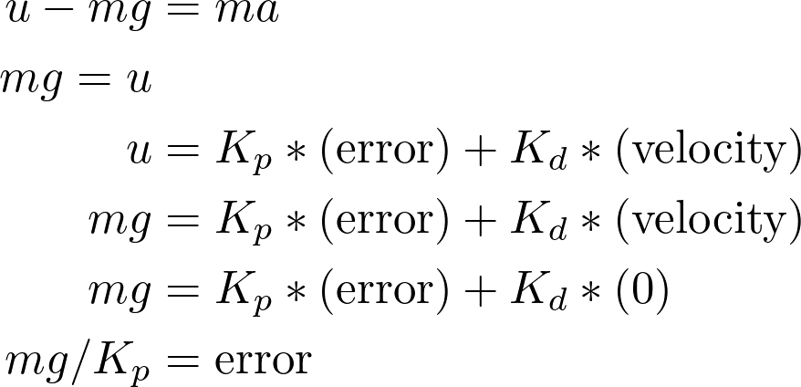
Proportional Integrative Derivative Control (PID)
How do we remove steady state errors (e.g. gravity)?
PD control law will result in a force balance with non-zero error
What is the steady state error with PD control?
z
mg
u

Slide 15
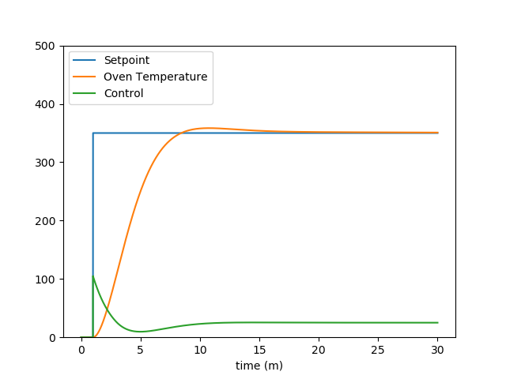
Proportional Integrative Derivative Control (PID)

Slide 16
PID tuning
Find KP first. Set KD = 0 , KI = 0, Increase KP until response is fast enough (typically some overshoot).
Or, increase until constant oscillation occurs, then reduce the gain by 30%.
Find KI 2nd. Slowly increase the integral level until steady state has acceptable error.
Find KD last. Increase KD to reduce overshoot (critically damped if desired, or until speed is set. )
https://en.wikipedia.org/wiki/PID_controller

Slide 17
Design Review

